Slide 1
OSPF Multi-Area

Slide 2
Resources
OSPF Configuration Guide
http://www.cisco.com/c/en/us/td/docs/ios-xml/ios/iproute_ospf/configuration/15-mt/iro-15-mt-book.html
OSPF Design Guide
http://www.cisco.com/c/en/us/support/docs/ip/open-shortest-path-first-ospf/7039-1.html
RFC 2328
https://www.ietf.org/rfc/rfc2328.txt

Slide 3
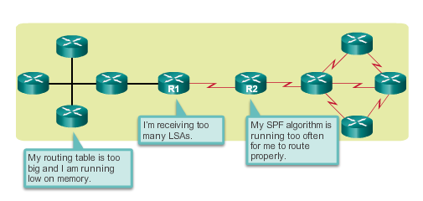
Why Multiarea OSPF? Single-Area OSPF
Single-area OSPF is useful in smaller networks. If an area becomes too big, the following issues must be addressed:
Large routing table (no summarization by default)
Large link-state database (LSDB)
Frequent SPF algorithm calculations
Notes:
6.1.1.1 Single-Area OSPF

Slide 4
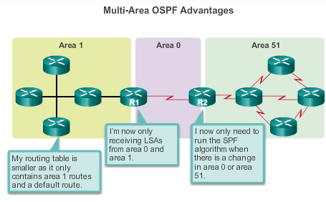
Why Multiarea OSPF? Multiarea OSPF
Multiarea OSPF requires a hierarchical network design and the main area is called the backbone area, or area 0, and all other areas must connect to the backbone area.
Notes:
6.1.1.2 Multiarea OSPF

Slide 5
Why Multiarea OSPF? OSPF Two-Layer Area Hierarchy
Multiarea OSPF is implemented in a two-layer area hierarchy:
Backbone (transit) area
Area whose primary function is the fast and efficient movement of IP packets.
Interconnects with other OSPF area types.
Called OSPF area 0, to which all other areas directly connect.
Regular (nonbackbone) area
Connects users and resources.
A regular area does not allow traffic from another area to use its links to reach other areas.
Notes:
6.1.1.3 OSPF Two-Layer Area Hierarchy
Cisco recommends max 50 routers in an area
Router be in a maximum of 3 areas

Slide 6
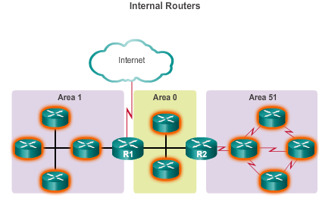
Why Multiarea OSPF? Types of OSPF Routers
Notes:
6.1.1.4 Types of OSPF Routers

Slide 7
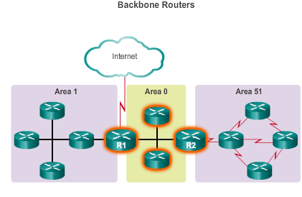
Why Multiarea OSPF? Types of OSPF Routers (cont.)
Notes:
6.1.1.4 Types of OSPF Routers

Slide 8
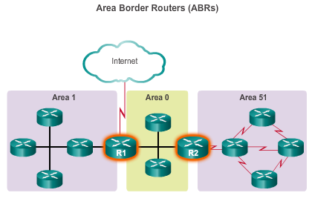
Why Multiarea OSPF? Types of OSPF Routers (cont.)
Notes:
6.1.1.4 Types of OSPF Routers

Slide 9
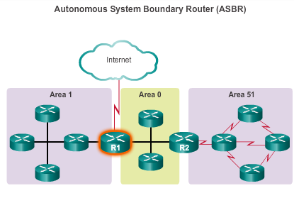
Why Multiarea OSPF? Types of OSPF Routers (cont.)
Notes:
6.1.1.4 Types of OSPF Routers

Slide 10
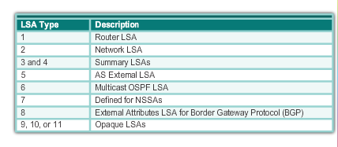
Multiarea OSPF LSA Operation OSPF LSA Types
Most common and covered in this course – 1 thru 5 & 7
Notes:
6.1.2.1 OSPF LSA Types

Slide 11
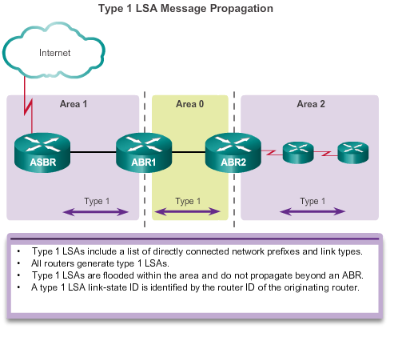
Multiarea OSPF LSA Operation OSPF LSA Type 1
Notes:
6.1.2.2 OSPF LSA Type 1

Slide 12
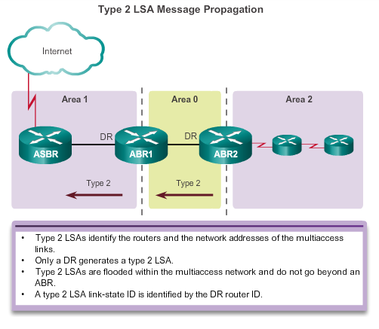
Multiarea OSPF LSA Operation OSPF LSA Type 2
Notes:
6.1.2.3 OSPF LSA Type 2
Network address & router IDs of all OSPF routers within the network
Network LSA represents a pseudonode (single virtual router)
DR generates LSA containing RIDs of nodes sharing multiacess network

Slide 13
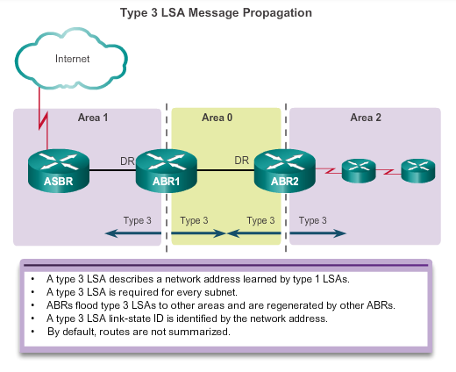
Multiarea OSPF LSA Operation OSPF LSA Type 3
Notes:
6.1.2.4 OSPF LSA Type 3
Type 3 LSA = the means for other areas to learn about networks outside their area

Slide 14
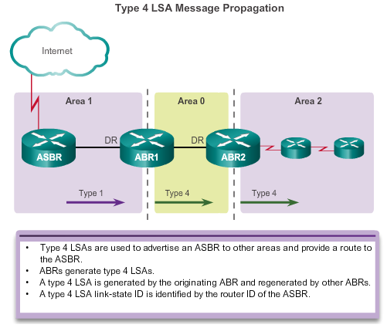
Multiarea OSPF LSA Operation OSPF LSA Type 4
Notes:
6.1.2.5 OSPF LSA Type 4

Slide 15
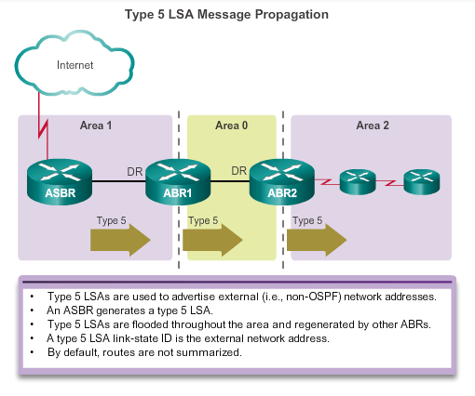
Multiarea OSPF LSA Operation OSPF LSA Type 5
Notes:
6.1.2.6 OSPF LSA Type 5

Slide 16
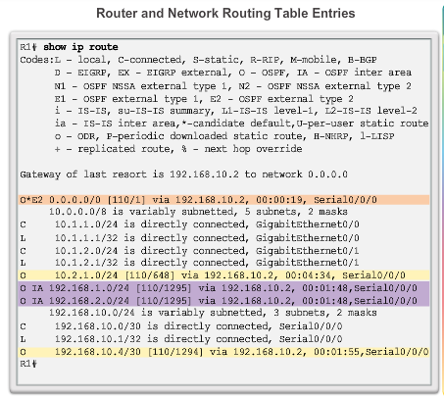
OSPF Routing Tables and Route Types OSPF Routing Table Entries
O – Router (type 1) and network (type 2) LSAs describe the details within an area (the route is intra-area).
O IA – Summary LSAs appear in the routing table as IA (interarea routes)
O E1 or OE 2 – External LSAs external type 1 (E1) or external type 2 (E2) routes
Notes:
6.1.3.1 OSPF Routing Table Entries
O E1 & O E2 = will be discussed in redistribution
O E1 = redistribution cost + cumulative cost
O E2 = redistribution cost only (default)

Slide 17
OSPF Path Selection
When a prefix (route) is learned as an intra-area route (O) and as an inter-area route (O IA) OSPF always prefers the intra-area route, regardless of cost.

Slide 18
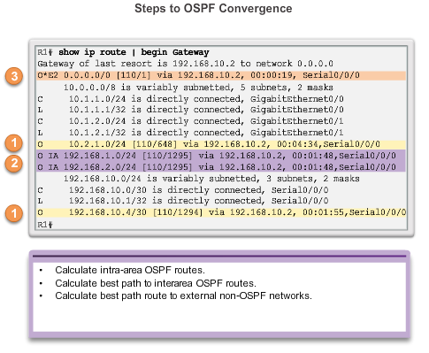
OSPF Routing Tables and Route Types OSPF Route Calculation
All routers calculate the best paths to destinations within their area (intra-area) and add these entries to the routing table.
All routers calculate the best paths to the other areas within the internetwork (interarea) or type 3 and type 4 LSAs.
All routers calculate the best paths to the external autonomous system (type 5) destinations. These are noted with either an O E1 or an O E2 route designator.
Notes:
6.1.3.2 OSPF Route Calculation

Slide 19
6.2 Configuring Multiarea OSPF
Notes:
6.2 Configuring Multiarea OSPF

Slide 20
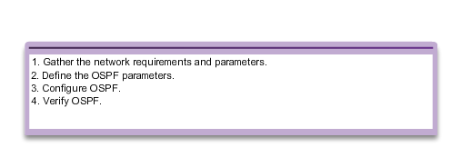
Configuring Multiarea OSPF Implementing Multiarea OSPF
Implementation Plan Steps
Notes:
6.2.1.1 Implementing Multiarea OSPF

Slide 21
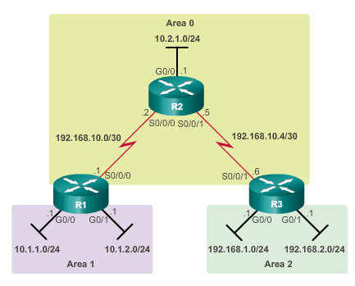
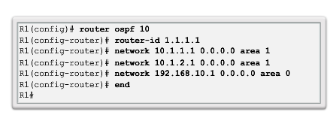
Configuring Multiarea OSPF Configuring Multiarea OSPF
Notes:
6.2.1.2 Configuring Multiarea OSPF

Slide 22
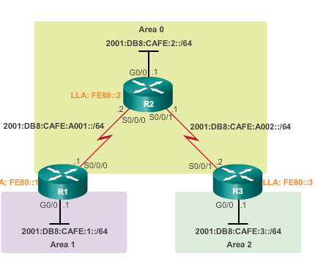
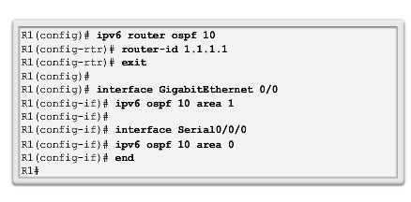
Configuring Multiarea OSPF Configuring Multiarea OSPFv3
Notes:
6.2.1.3 Configuring Multiarea OSPFv3

Slide 23
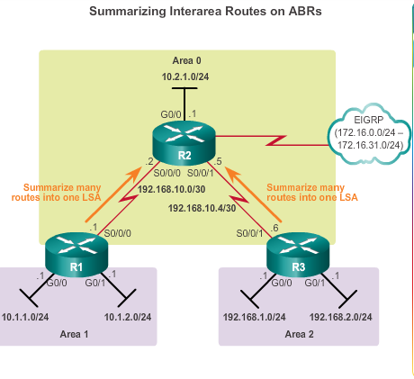
OSPF Route Summarization Interarea Route Summarization
Occurs on ABRs and applies to routes from within each area
Notes:
6.2.2.2 Interarea and External Route Summarization

Slide 24
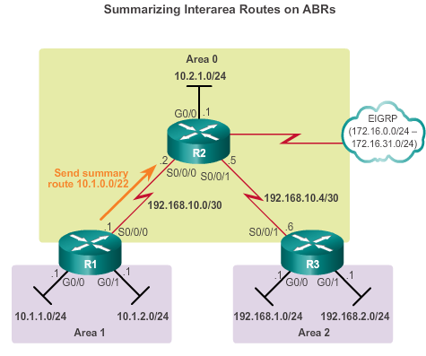
OSPF Route Summarization Interarea Route Summarization
Notes:
6.2.2.3 Interarea Route Summarization
Example

Slide 25
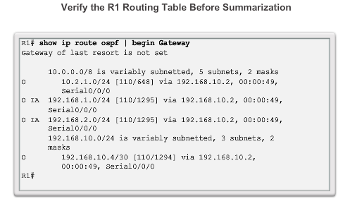
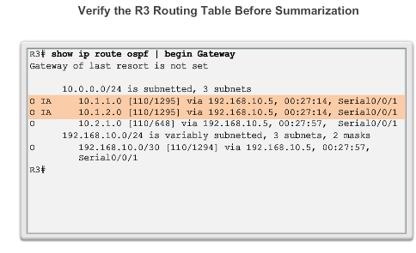
OSPF Route Summarization Interarea Route Summarization (cont.)
Notes:
6.2.2.3 Interarea Route Summarization

Slide 26
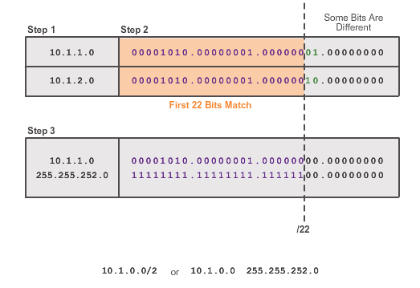
OSPF Route Summarization Calculating the Summary Route
2
Notes:
6.2.2.4 Calculating the Summary Route

Slide 27
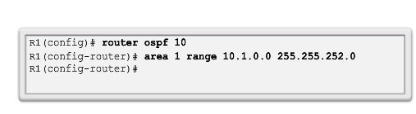
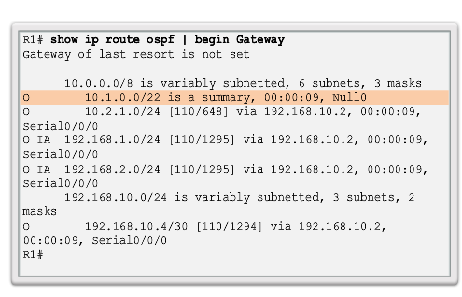
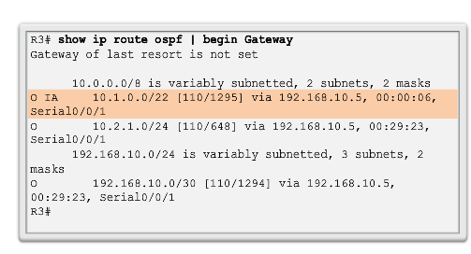
OSPF Route Summarization Configuring Interarea Route Summarization
R1
R3
Notes:
6.2.2.5 Configuring Interarea Route Summarization
Can only be configured on ABR (as cannot summarise LSAs that are flooded within an area)

Slide 28
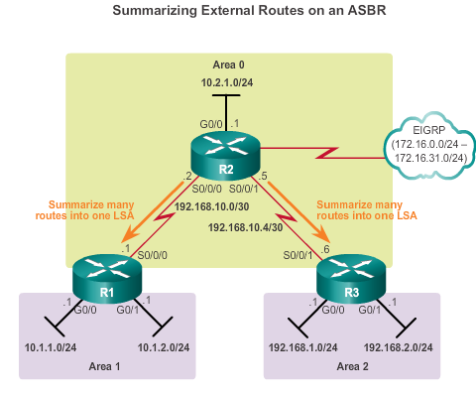
OSPF Route Summarization External Route Summarization
Specific to external routes that are injected into OSPF via route redistribution; ASBRs summarize external routes
Notes:
6.2.2.2 Interarea and External Route Summarization

Slide 29
External Summarization
Configure an ASBR to summarize external routes.
Router(config-router)#
summary-address ip-address mask [not-advertise] [tag tag]
Parameter | Description
ip-address | The summary address designated for a range of addresses.
mask | The IP subnet mask used for the summary route.
not-advertise | (Optional) Used to suppress routes that match the address/mask pair.
tag tag | (Optional) A tag value that can be used as a “match” value to control redistribution via route maps.
Notes:
Summarization of external routes can be done on an ASBR for type-5 LSAs (redistributed routes) before injecting them into the OSPF domain. A summary route to null 0 is automatically created for each summary range.

Slide 30
External Summarization
OSPF Area 1
172.16.64.0 /24
ABR
OSPF Area 0
External AS – RIPv2
172.16.32.0 /24 – 172.16.63.0 /24
.1
R1
R2
R1(config)# router ospf 100
R1(config-router)# network 172.16.64.1 0.0.0.0 area 1
R1(config-router)# summary-address 172.16.32.0 255.255.224.0
R1(config-router)#
Notes:
RIPv2 routes must also be redistributed into OSPF in this example; redistribution is covered in Chapter 4.

Slide 31
Verifying Multiarea OSPF Verifying Multiarea OSPF
The same verification commands are used to verify single-area OSPF and can be used to verify multiarea OSPF:
show ip ospf neighbor
show ip ospf
show ip ospf interface
Commands specific to multiarea information include:
show ip protocols
show ip ospf interface brief
show ip route ospf
show ip ospf database
Note: For OSPFv3, substitute ip with ipv6.
Notes:
6.2.3.1 Verifying Multiarea OSPF

Slide 32
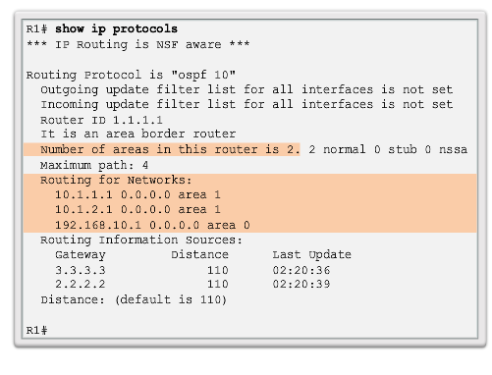
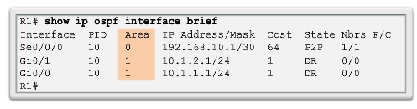
Verifying Multiarea OSPF Verifying General Multiarea OSPF Settings
Notes:
6.2.3.2 Verify General Multiarea OSPF Settings

Slide 33
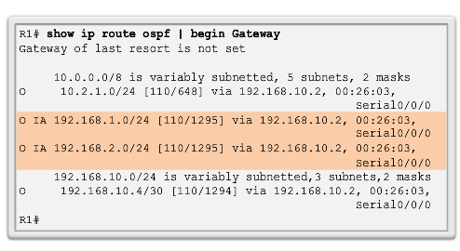
Verifying Multiarea OSPF Verify the OSPF Routes
Notes:
6.2.3.3 Verify the OSPF Routes

Slide 34
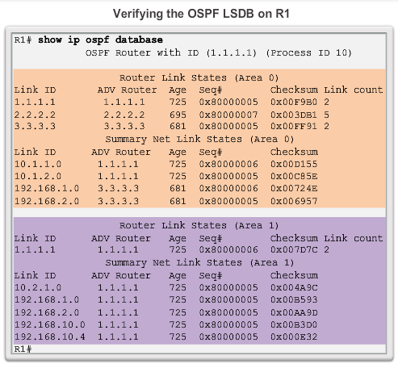
Verifying Multiarea OSPF Verifying the Multiarea OSPF LSDB
Notes:
6.2.3.4 Verify the Multiarea OSPF LSDB

Slide 35
Chapter 6: Summary Multiarea OSPF Summary
Better choice for larger networks than single-area.
Solves the issues of large routing table, large LSDB, and frequent SPF algorithm calculations.
Main area is called the backbone area, or area 0.
Recalculating the database is kept within an area.
Four different types of OSPF routers:
Internal router
Backbone router
ABR
ASBR
A router simply becomes an ABR when it has two network statements in different areas.
Notes:
Chapter 6 Summary

Slide 36
Chapter 6: Summary Multiarea OSPF Summary (cont.)
Link-state advertisements (LSAs) are the building blocks of OSPF.
Type 1 LSAs are referred to as the router link entries.
Type 2 LSAs are referred to as the network link entries and are flooded by a DR.
Type 3 LSAs are referred to as the summary link entries and are created and propagated by ABRs.
A type 4 summary LSA is generated by an ABR only when an ASBR exists within an area.
Type 5 external LSAs describe routes to networks outside the OSPF autonomous system, originated by the ASBR and are flooded to the entire autonomous system.
SPF tree is used to determine the best paths.
OSPF routes in an IPv4 routing table are identified using the following descriptors: O, O IA, O E1, or O E2.
Notes:
Chapter 6 Summary

Slide 37
Chapter 6: Summary Multiarea OSPF Summary (cont.)
The following example displays a multiarea OSPF configuration:
R1(config)# router ospf 10
R1(config-router)# router-id 1.1.1.1
R1(config-router)# network 10.1.1.1 0.0.0.0 area 1
R1(config-router)# network 10.1.2.1 0.0.0.0 area 1
R1(config-router)# network 192.168.10.1 0.0.0.0 area 0
Does not perform autosummarization, but can be manually configured using the summary-address address mask router configuration mode command
Notes:
Chapter 6 Summary

Slide 38
Chapter 6: Summary Multiarea OSPF Summary (cont.)
The following commands are used to verify OSPF configurations:
show ip ospf neighbor
show ip ospf
show ip ospf interface
show ip protocols
show ip ospf interface brief
show ip route ospf
show ip ospf database
Notes:
Chapter 6 Summary

Slide 39


